Slide 1
Pengenalan RDBMS & SQL

Slide 2
Database and Database System

Slide 3
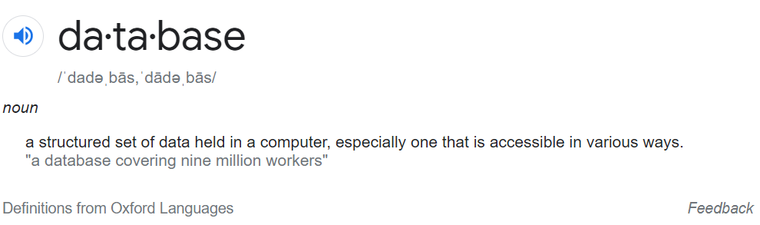
Apa itu database?
Bagaimana kita membuat data kita terstruktur?
Bagaimana kita mengambil informasi tanpa harus merubah struktur data?
DBMS

Slide 4

Database Management System (DMS / DBMS)
Memilih struktur/sistem penyimpanan informasi sangat lah penting
Sistem yang dipilih akan mempengaruhi:
Tipe data/informasi yang bisa kita dapatkan
Bagaimana cara kita “interrogate” data yang dikumpulkan
Sampai sejauh mana kita memanfaatkan kemampuan device kita
Seberapa mudah untuk membagikan data

Slide 5
Alternatif DBMS
Tabular
Spreadsheet
Relational Database
Microsoft Excel
Google Sheet
Oracle DBMS
Non Tabular
Graph
Document Based
Key-Value Pair
Wiki Link
Wiki Link
Wiki Link
Ms Access
Ms SQL Server
MySQL

Slide 6
Manfaat Penggunaan Database Relational
Representasi yang akurat atas data yang kompleks
Memungkinkan untuk bekerja dengan query yang fleksible
Cocok untuk penggunaan kolaboratif
Teknologi yang sudah lama dikembangkan dan digunakan
Mengurangi resiko penyimpanan informasi yang duplikat
Dapat melakukan lebih banyak jenis analisis (query) disbanding spreadsheet
Satu database yang sama dapat diakses oleh banyak user
Support banyak tersedia dan teknologi telah dikenal oleh banyak pihak

Slide 7
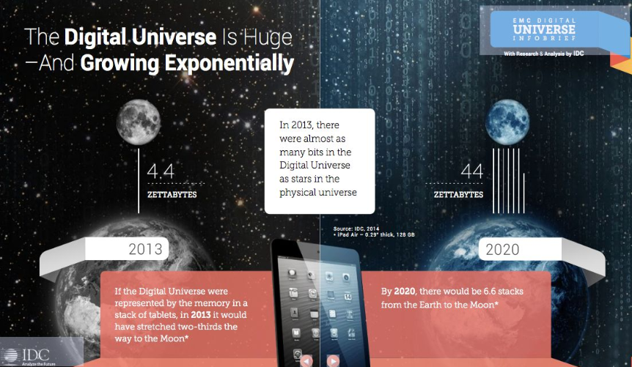
Data Management Sekarang
Database relational memang masih sangat popular, tapi masih banyak data-data yang sulit untuk di manage menggunakan teknologi ini
Social Network Data (Facebook, Twitter)
Multimedia data (Instagram, Tiktok, Spotify)
Data Streams
(YouTube, Netflix)
Spatial Data
(Google Map, Waze)
Textual Data (news portal)
dan tipe-tipe data lainnya

Slide 8
Kenapa SQL?
Kenapa tidak Spreadsheet atau ACL

Slide 9
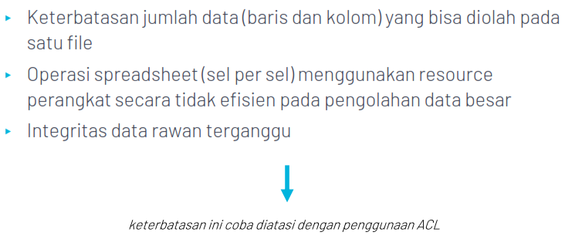
Keterbatasan Spreadsheet
Notes:
In a relational database, you do not specify the access route to the tables, and you do not need to
know how the data is arranged physically.
To access the database, you execute a structured query language (SQL) statement, which is the
American National Standards Institute (ANSI) standard language for operating relational
databases. SQL is a set of statements with which all programs and users access data in an Relational
Database.

Slide 10
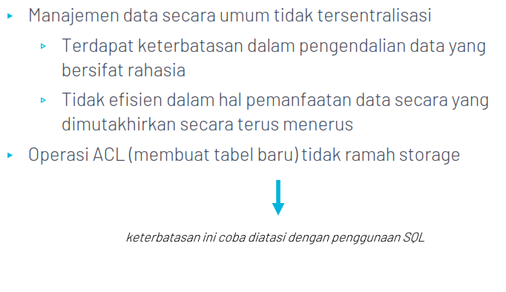
Keterbatasan ACL
Notes:
In a relational database, you do not specify the access route to the tables, and you do not need to
know how the data is arranged physically.
To access the database, you execute a structured query language (SQL) statement, which is the
American National Standards Institute (ANSI) standard language for operating relational
databases. SQL is a set of statements with which all programs and users access data in an Relational
Database.

Slide 11
Apa itu SQL?
Structured Query Language (SQL)

Slide 12
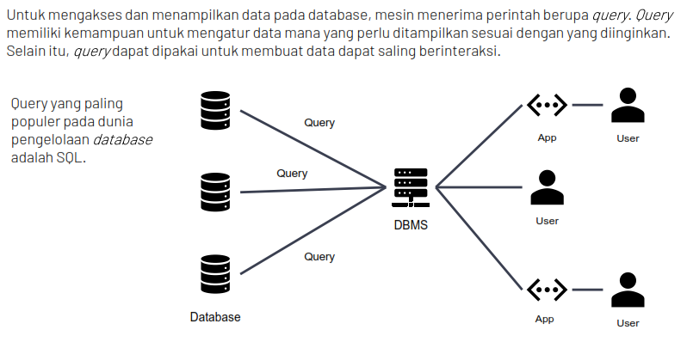
Structured Query Language (SQL)
Notes:
In a relational database, you do not specify the access route to the tables, and you do not need to
know how the data is arranged physically.
To access the database, you execute a structured query language (SQL) statement, which is the
American National Standards Institute (ANSI) standard language for operating relational
databases. SQL is a set of statements with which all programs and users access data in an Relational
Database.

Slide 13
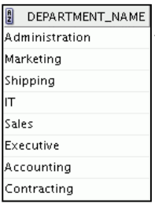
Structured Query Language (SQL)
Merupakan bahasa standar ANSI untuk mengoperasikan basis data relasional
Efisien, mudah dipelajari, dan digunakan
Functionally complete (dengan SQL, kita bisa mendefinisikan, mengambil, dan memanipulasi data dalam table)
SELECT department_name FROM departments;
RDBMS
Server
Notes:
In a relational database, you do not specify the access route to the tables, and you do not need to
know how the data is arranged physically.
To access the database, you execute a structured query language (SQL) statement, which is the
American National Standards Institute (ANSI) standard language for operating relational
databases. SQL is a set of statements with which all programs and users access data in an Relational
Database.

Slide 14
Pekerjaan yang dapat dilakukan dengan SQL
• Melakukan query atas data
• INSERT, UPDATE, DELETE baris data pada tabel
• CREATE, REPLACE, ALTER and DROP objek pada basis data
• Mengendalikan akses ke basis data dan objek didalamnya
• Menjaga kosistensi dan integritas basis data
SELECT department_name FROM departments;
RDBMS
Server
Notes:
SQL provides statements for a variety of tasks, including:
• Querying data
• Inserting, updating, and deleting rows in a table
• Creating, replacing, altering, and dropping objects
• Controlling access to the database and its objects
• Guaranteeing database consistency and integrity
SQL unifies all of the preceding tasks in one consistent language and enables you to work with
data at a logical level

Slide 15

Bagaimana SQL bekerja dalam aplikasi/program
Aplikasi atau program biasanya memungkinkan pengguna mengakses basis data tanpa menggunakan SQL secara langsung
SELECT department_name FROM departments;
RDBMS
Server
Hasil Query
Pengguna
Aplikasi
Notes:
Application programs often allow users access to the database
without using SQL directly, but these applications, in turn, must use SQL when executing the
user’s request.

Slide 16
RDBMS Client dan SQL Statement
Adminstrator basis data/pengembang aplikasi menggunakan client tools untuk menjalankan/mengembangkan SQL statement ke basis data
Via Client Tools
SELECT department_name FROM departments;
RDBMS
Server
Hasil Query
DbAdmin/
Programer
Notes:
Application programs often allow users access to the database
without using SQL directly, but these applications, in turn, must use SQL when executing the
user’s request.

Slide 17




RDBMS Client dan SQL Statement
Perlu dipastikan bahwa client tools yang digunakan kompatibel dengan RDMBS yang akan diakses
RDBMS
Client
SQL Plus
SQL developer
SQL Server Management Studio
MySQL Workbench
PgAdmin
Notes:
Beberapa RDBMS client tools dapat digunakan pada multi RDBMS

Slide 18
SQL dalam Pengawasan
Sebagai RDBMS Client Tools

Slide 19


Bagaimana skema mengaudit dengan SQL?
Auditor mengakses langsung basis data lingkungan pengembangan/staging/data warehouse menggunakan RDBMS client
SELECT department_name FROM departments;
Mengembangkan
script
RDBMS
Server lingkungan pengembangan/staging
Hasil Query
Tampilkan/
ekspor hasil pengujian
Auditor
SQL Client
aplikasi objek audit lingkungan pengembangan

Slide 20
Yang Perlu Diperhatikan Auditor
Mendapatkan informasi berikut:
Jenis RDBMS aplikasi > mempengaruhi RDBMS client yang akan digunakan
IP address server lingkungan pengembangan/staging untuk mengembangkan query SQL pengujian
User dan password yang akan digunakan untuk mengakses
Informasi awal perbedaan server lingkungan pengembangan dengan lingkungan live/production
Jika auditor langsung mengakses ke basis data auditi , perlu dipertimbangkan, hal berikut:
Waktu peak transaksi
Query direviu terlebih dahulu oleh auditi
Hanya query menggunakan SELECT (read only)

Slide 21
Overview SQL Server Management Studio
Sebagai RDBMS Client Tools

Slide 22
SQL Server Management Studio
Tools RDBMS client untuk pengembangan dan administrasi basis data
Digunakan pada lingkungan basis data SQL Server
Banyak digunakan oleh database developer dan admin karena:
Cost-free
Advanced user experience
Various add-in options
Easy installation
Notes:
SQL Server Management Studio, also known as SSMS, is an intuitive and multi-purpose database development and administration tool primarily used by SQL Professionals including SQL database developers, database administrators and infrastructure teams to manage SQL Server environments.

Slide 23
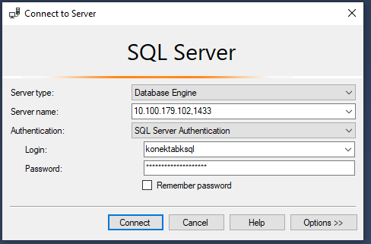
Koneksi ke basis data
Setelah instalasi, untuk terhubung ke basis data klien pengawasan auditor membutuhkan:
IP address basis data auditi
User basis data yang diberikan auditi (beserta password)
IP address basis data auditi
(port opsional)
User basis data beserta password

Slide 24
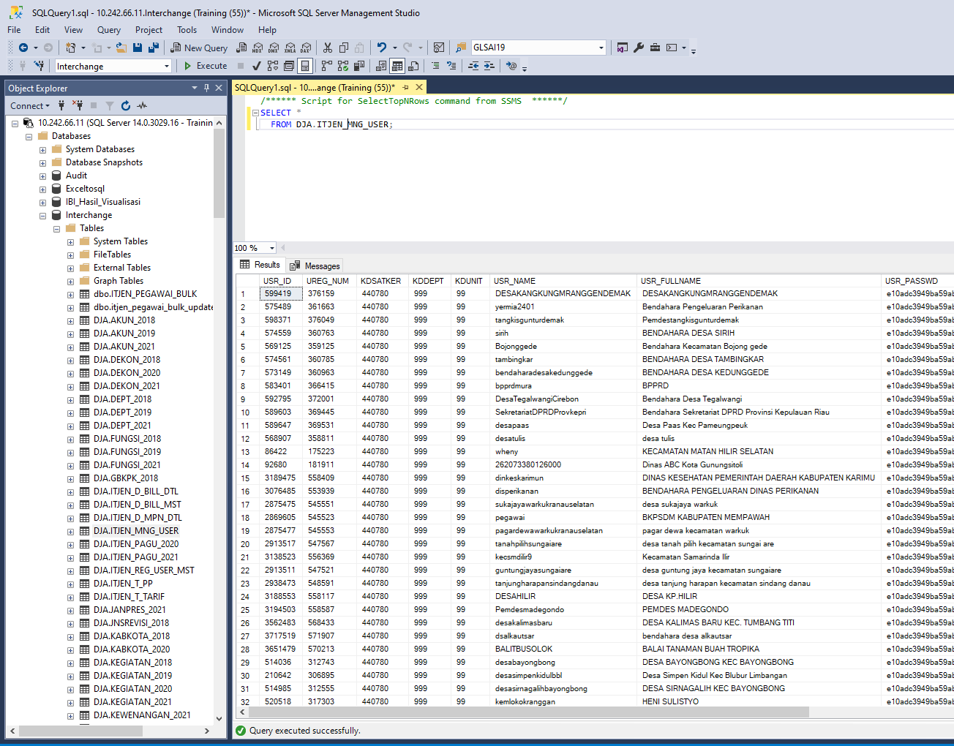
Interface Aplikasi SSMS
Query editor
Basis data yang diakses
Table dalam basis data
Isi table yang aktif (sedang di-query)
Indikator sukses/gagal query
Notes:
Interface Utama Aplikasi SSMS terdiri dari:
Object explorer
Query Editor
Result view

Slide 25
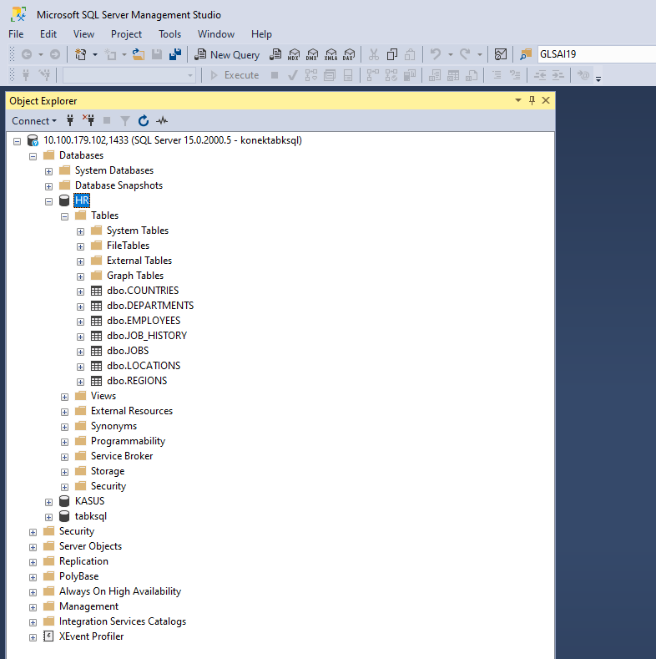
Object Explorer
Menyajikan hirarki objek pada server basis data
Memungkinkan kita untuk:
Mencari objek tertentu
View and edit properties objek
Manajemen objek-objek
Menjalankan custom report
Notes:
Object Explorer is the most frequently used feature in SQL Server Management Studio. Object Explorer has a user interface that offers a convenient hierarchical view of server objects, similar to Windows Explorer with its system of folders, subfolders, files, etc. Among the many helpful options, it allows you to do the following:
Search a specific object
View and edit object properties
Manage objects represented as nodes
Run custom reports

Slide 26
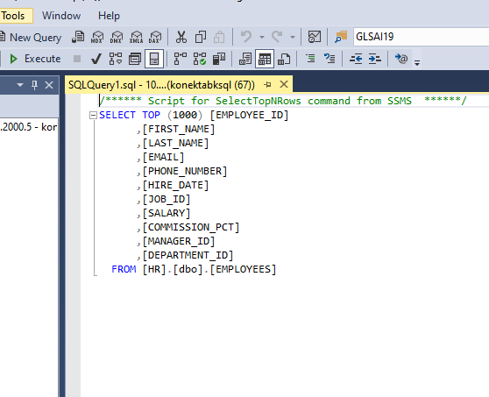
Query Editor
Tombol untuk mengeksekusi query
Untuk menyusun/mengembangkan, mengeksekusi, dan debugging kode SQL
Interface utama yang akan digunakan auditor dalam mengembangkan script pengujian
Untuk menjalankan script yang telah dibuat klik tombol execute di tab menu, atau F5 pada keyboard
Notes:
The primary tasks of SQL Server Management Studio are writing, executing, and debugging T-SQL code. To implement these functions, SSMS provides an advanced SQL Query Editor with IntelliSense support. Equipped with this technology, the tool is able to auto-complete code. This means, as soon as you start writing code, the software suggests variants to finish the row. This helps accelerate the code writing process and make it more accurate. There are many more helpful options in SSMS Query Editor:
Building scripts with T-SQL and XQuery statements
SQLCMD Scripts editor
MDX, DMX, and XML/A editors
Code formatting, including syntax highlighting
Code debugging
Commenting and uncommenting selected lines
Code lines numeration
Drag-and-drop text
Selected code executing
Getting query results as text
Saving results to file
Bookmarks
Integration with Query Execution Plan

Slide 27
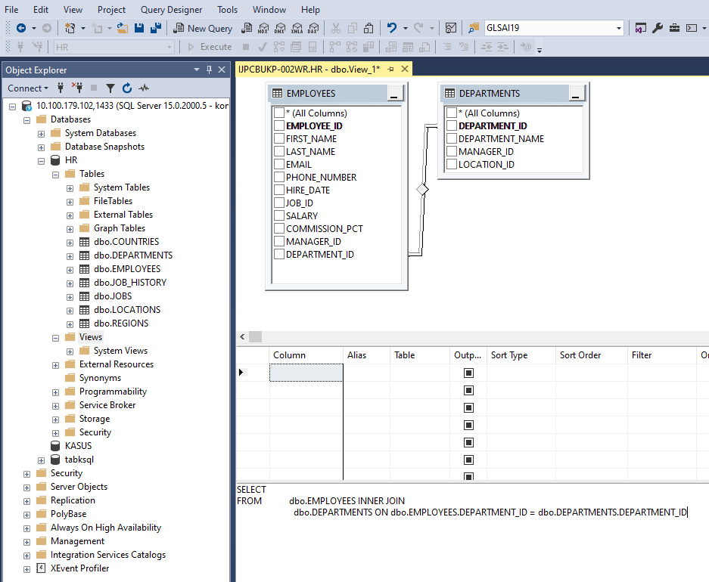
Query Designer
Alat bantu dalam bentuk GUI untuk user dalam mengembangkan script
Dapat diakses menggunakan menu Query > Design ini Query Editor
Notes:
Query and View Designer allows users to develop queries and views.
A significant plus is that you can create database queries using the mouse only – there is no need to write code manually.
The Designer also allows you to select a particular SQL query and create a similar one in the Editor.

Slide 28
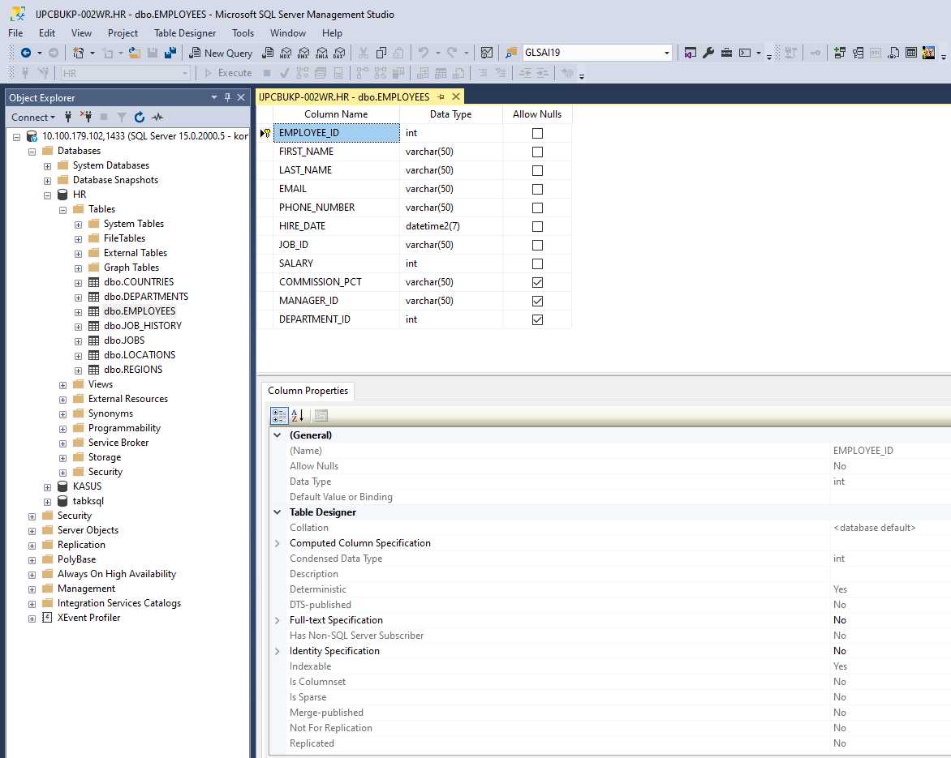
Table Designer
Digunakan untuk mendesain dan visualisasi suatu tabel
Tabel designer memungkinkan user untuk create, edit, delete table maupun komponennya tanpa menggunakan SQL code
Klik kanan suatu table > Design
Notes:
This visual tool lets users design and visualize tables in a database.
Table Designer makes it possible to create, edit, and delete both tables and their components (columns, indexes, keys, relationships, and constraints).
The main advantage is that you can perform all these tasks in a visual mode, without manual typing of SQL code.

Slide 29
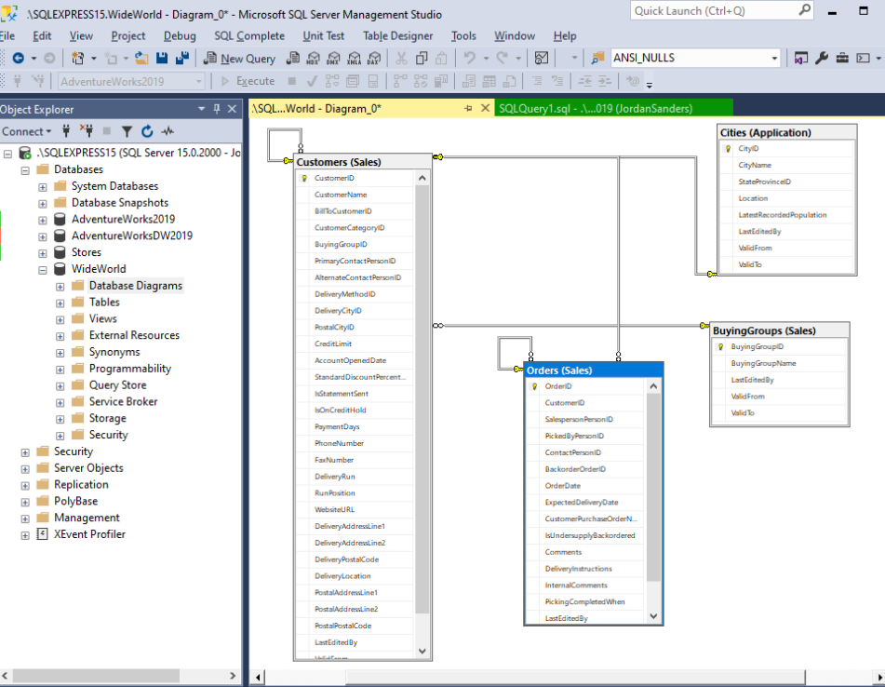
Database Designer
Fitur ini memvisualisasikan tiap hubungan antar tabel dalam suatu basis data tertentu, termasuk komponennya (tables, columns, constraints, and dependencies)
Notes:
Database Designer is another visual tool that assists in designing databases and their components.
It visualizes each database with tables, columns, constraints, and dependencies.
Similarly, you can create and edit databases using diagrams.
With SQL Server Studio, it is possible to work on one or several diagrams – there can be as many of them as necessary.
Also, each database can be a part of multiple diagrams. This way, you can focus on different database aspects.

Slide 30
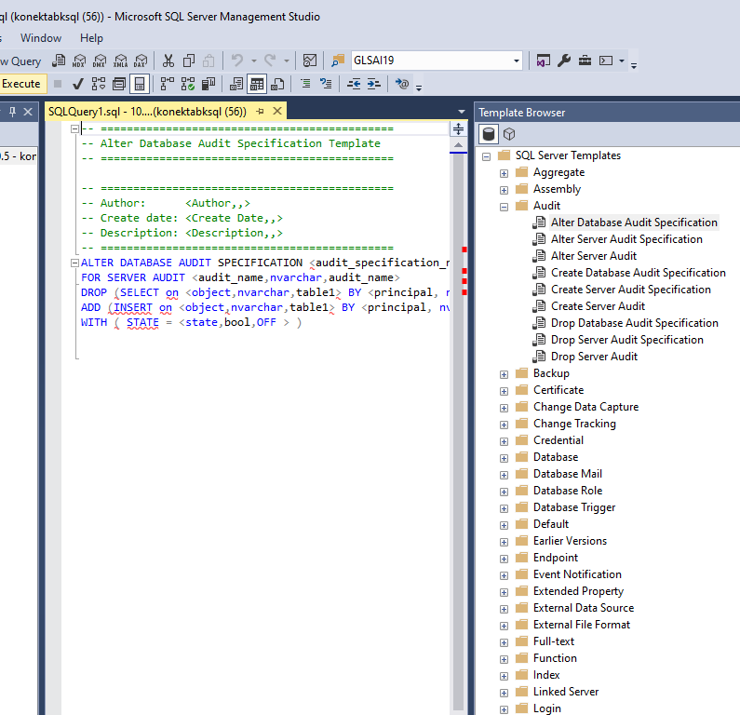
Template Explorer
Template adalah file yang telah berisi script SQL yang ready-made
Dapat diakases melalui View > Template Explorer
Notes:
Templates are files with ready-made SQL scripts that create standard objects (databases, tables, views, indexes, stored procedures, triggers, statistics, and functions). Besides, there are templates for SQL Server Management tasks. You can use them to create extended properties, linked servers, logins, users, roles, and Analysis Services.
There is a large collection of predefined templates available in Template Explorer. Refer to any such file and use the code in the Editor with many customization options. Additionally, you can make custom code templates. All such scripts are organized in folders, so you will have to either take the existing folders or develop a new folder structure.

Slide 31
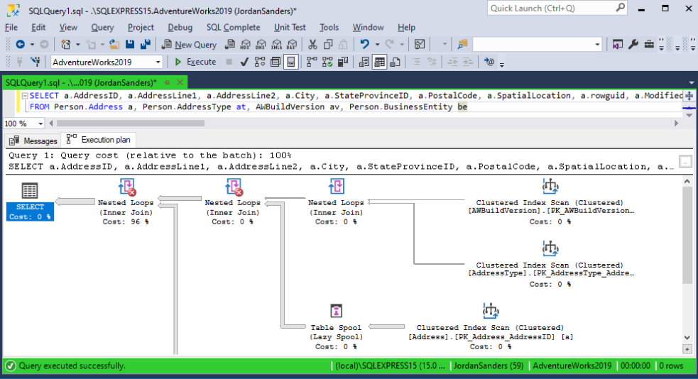
Query Execution Plan
Query execution plan adalah urutan langkan operasi yang dilakukan pada SQL Server untuk menghasilkan query
Untuk mereviu query sebelum dijalankan (terutama yang sensitive dengan resource)
Notes:
A query execution plan is the sequence of operations on SQL Server that you perform to obtain a SQL query result. Before the server executes a SQL query, it must analyze the instructions and define the most efficient way of execution. For that, it uses the Query Optimizer component. Its input data is the query execution plan itself.
In SQL Server Management Studio, you can view a query execution plan and identify the most resource-intensive operations. Then, you can adjust the query to achieve optimal results.

